Slide 1
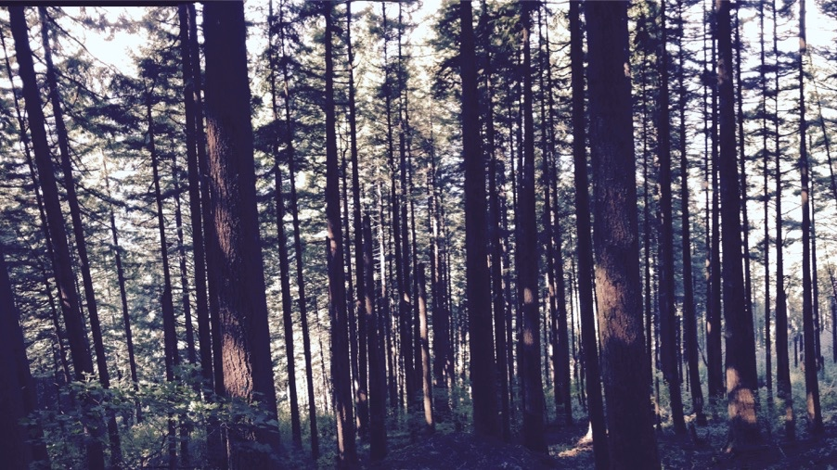
Plants aren’t dumb Using optimality theory to understand big questions in plant ecophysiology
Nick Smith
Department of Biological Sciences
Texas Tech University
nick.smith@ttu.edu; @nick_greg_smith

Slide 2
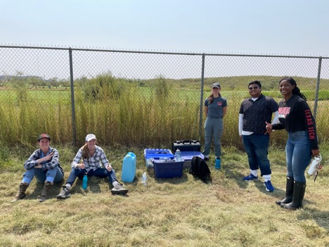
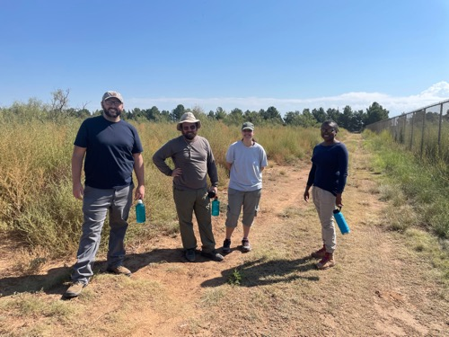
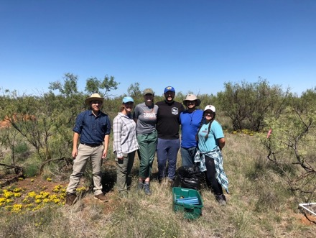
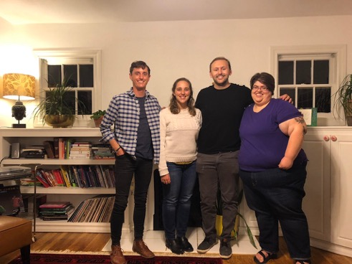





Acknowledgements
nick.smith@ttu.edu; @nick_greg_smith
Current lab members
Jeff Chieppa (postdoc)
Brad Posch (postdoc)
Evan Perkowski (PhD student)
Zinny Ezekannagha (PhD student)
Risa McNellis (MS; now lab tech)
Morgan Appell (undergrad)
Joseph Terrones (undergrad)
Former lab members
Lizz Waring (postdoc; now Asst. Prof at Northeastern State U)
Helen Scott (MS; now in industry and PhD student at BU)
Jorge Ochoa (undergrad; now working for the Army)
Jose Villeda (undergrad; now in industry)
Leah Ortiz (undergrad; now in industry)
Collaborators at TTU and around the world
Funding
NSF
USDA
NPS
USGS
Schmidt Futures

Slide 3
Why do people care about plants?
nick.smith@ttu.edu; @nick_greg_smith

Slide 4
Why do people care about plants?
nick.smith@ttu.edu; @nick_greg_smith

Slide 5
Why do people care about plants?
nick.smith@ttu.edu; @nick_greg_smith

Slide 6
Why do people care about plants?
nick.smith@ttu.edu; @nick_greg_smith

Slide 7
Why do people care about plants?
nick.smith@ttu.edu; @nick_greg_smith

Slide 8
Why do people care about plants?
nick.smith@ttu.edu; @nick_greg_smith

Slide 9
Why do people care about plants?
nick.smith@ttu.edu; @nick_greg_smith

Slide 10
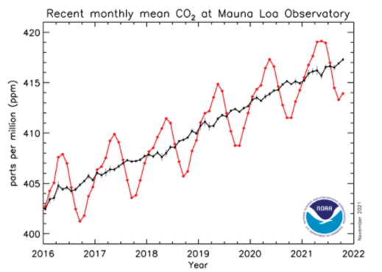
Why do people care about plants?
nick.smith@ttu.edu; @nick_greg_smith

Slide 11
In other words: plants provide ecosystem services
nick.smith@ttu.edu; @nick_greg_smith
FNAL

Slide 12
Including photosynthesis
nick.smith@ttu.edu; @nick_greg_smith
FNAL

Slide 13
Photosynthesis provides the foundation for other services
nick.smith@ttu.edu; @nick_greg_smith
FNAL

Slide 14
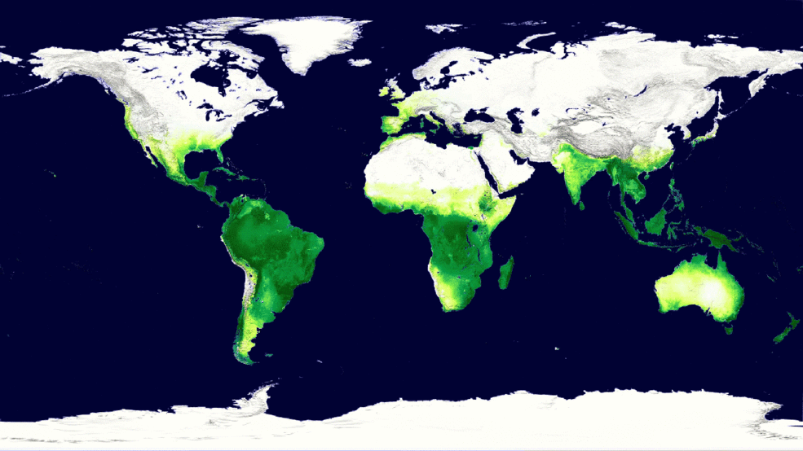
Photosynthesis is a dynamic process that is likely to be impacted by global change
nick.smith@ttu.edu; @nick_greg_smith
MODIS, NASA

Slide 15
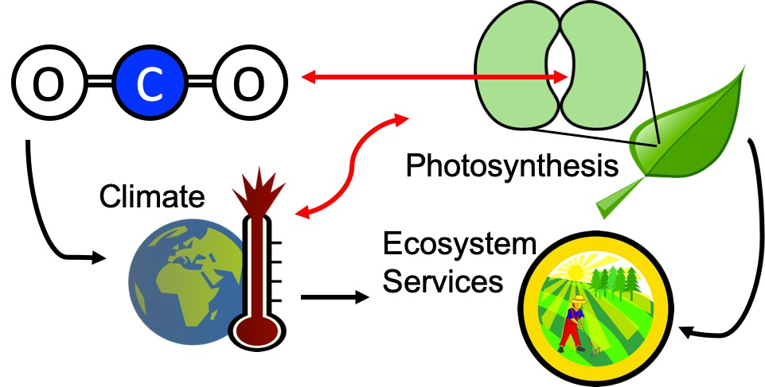
Our lab examines photosynthesis as a regulator of global change impacts on ecosystem services
nick.smith@ttu.edu; @nick_greg_smith

Slide 16
Photosynthesis is important! An example…
nick.smith@ttu.edu; @nick_greg_smith

Slide 17
Photosynthesis is important! An example…
nick.smith@ttu.edu; @nick_greg_smith
Data from IPCC (2013)

Slide 18
Photosynthesis is important! An example…
nick.smith@ttu.edu; @nick_greg_smith
Photosynthesis
Data from IPCC (2013)

Slide 19
Photosynthesis is important! An example…
nick.smith@ttu.edu; @nick_greg_smith
Photosynthesis
A small percentage change in photosynthesis can have large consequences for climate
Data from IPCC (2013)

Slide 20
But predictions are uncertain!
nick.smith@ttu.edu; @nick_greg_smith
Friedlingstein et al. (2014)

Slide 21
But predictions are uncertain!
nick.smith@ttu.edu; @nick_greg_smith
Future model uncertainty (14 Pg) > current fossil fuel emissions (9.5 Pg)
Friedlingstein et al. (2014)

Slide 22
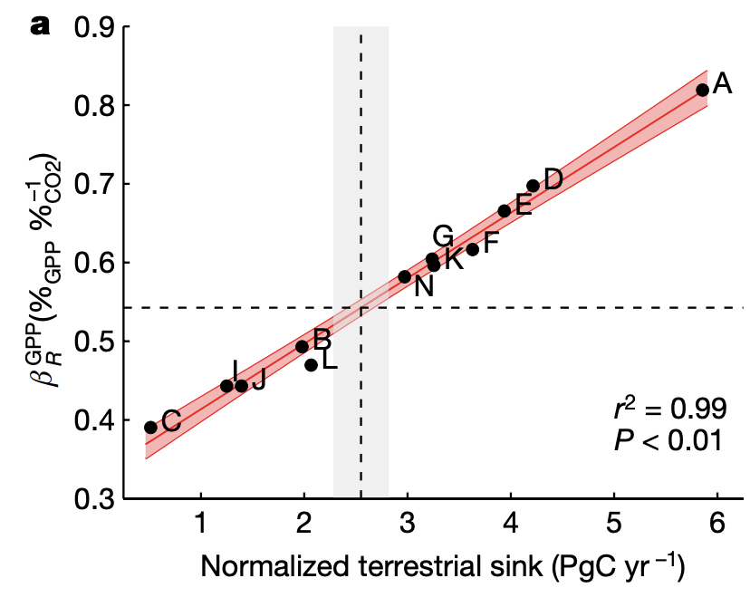
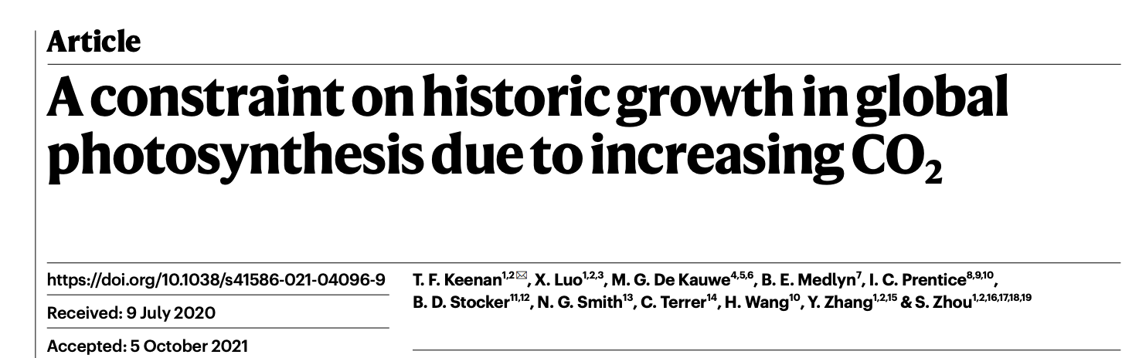
This uncertainty is driven by uncertainty in photosynthesis
nick.smith@ttu.edu; @nick_greg_smith
Friedlingstein et al. (2014)
Keenan et al. (2021)

Slide 23
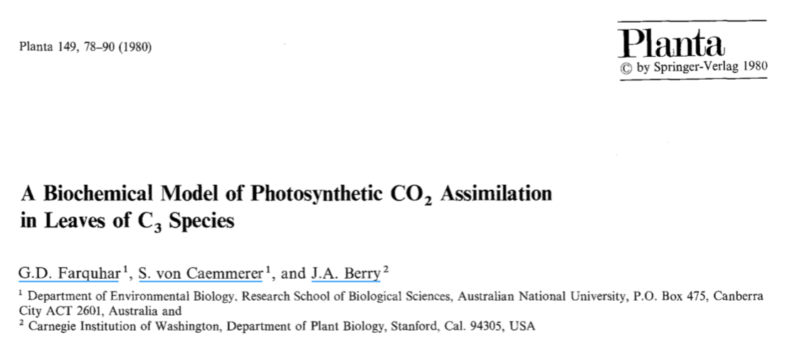
Why the uncertainty? Theoretical models for photosynthesis exist
nick.smith@ttu.edu; @nick_greg_smith

Slide 24
These produce short term responses that match data
nick.smith@ttu.edu; @nick_greg_smith

Slide 25
Why the uncertainty? Long-term responses differ from short-term responses due to acclimation
nick.smith@ttu.edu; @nick_greg_smith

Slide 26
nick.smith@ttu.edu; @nick_greg_smith
Dumb plants

Slide 27
nick.smith@ttu.edu; @nick_greg_smith
Acclimated to high light
Acclimated to low light

Slide 28
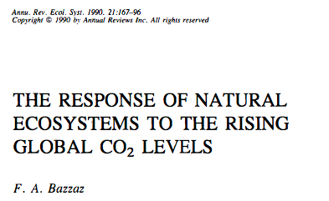
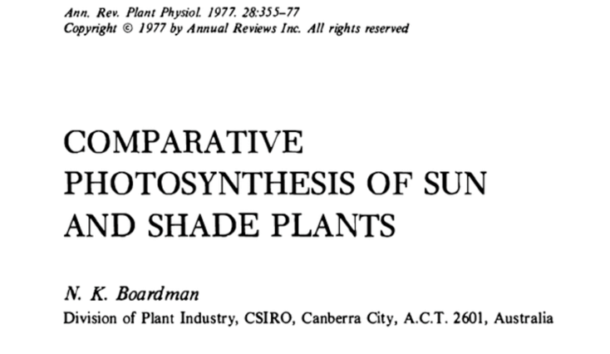
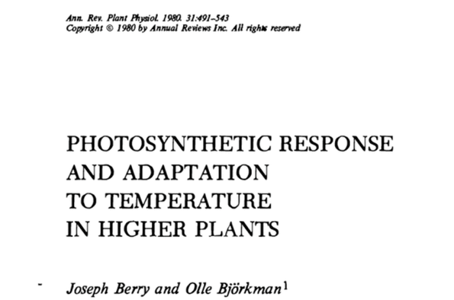
Acclimation is ubiquitous and well known…
nick.smith@ttu.edu; @nick_greg_smith
Temperature: Berry & Björkman (1980)
CO₂: Bazzaz (1990)
Light: Boardman (1977)

Slide 29
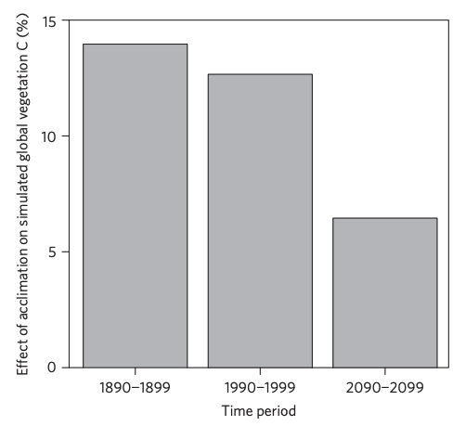
…and can impact carbon cycling and climate
nick.smith@ttu.edu; @nick_greg_smith
Acclimation increase future C storage by ~6%
Acclimation alters future temperature by >1°C
Smith et al. (2017) Nature Climate Change
Smith et al. (2017) JAMES

Slide 30
Unfortunately, no theoretical model for photosynthetic acclimation exists
nick.smith@ttu.edu; @nick_greg_smith

Slide 31
Lack of theory results in…
nick.smith@ttu.edu; @nick_greg_smith

Slide 32
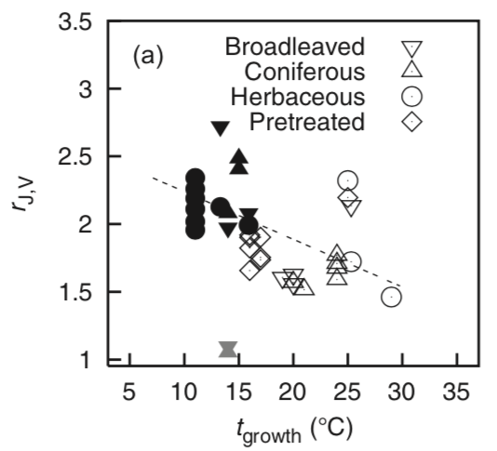
Lack of theory results in…
nick.smith@ttu.edu; @nick_greg_smith
Unreliable future predictions (overparameterization, tuning)
Reliance on statistical models
Resulting change in simulated photosynthesis
Physiological parameter
Environmental condition
Kattge and Knorr (2007) PC&E
Smith et al. (2017) JAMES

Slide 33
Lack of theory results in…
nick.smith@ttu.edu; @nick_greg_smith
Inability to test mechanisms
Resulting change in simulated photosynthesis
Physiological parameter
Environmental condition
Kattge and Knorr (2007) PC&E
Smith et al. (2017) JAMES

Slide 34
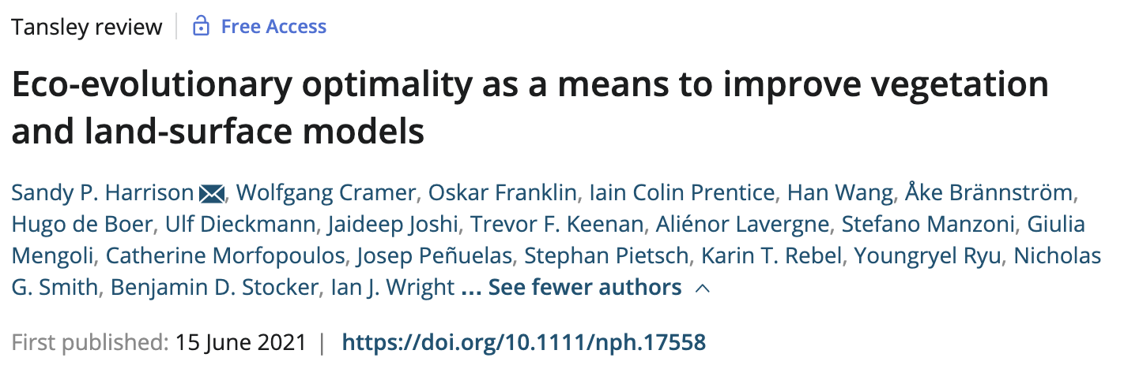
So, we developed a mechanistic model of photosynthetic acclimation Based on optimization and the first principles of plant physiological theory
nick.smith@ttu.edu; @nick_greg_smith

Slide 35
Optimization: Least cost theory
nick.smith@ttu.edu; @nick_greg_smith
Optimally, plants will maintain fastest rate of photosynthesis at the lowest summed resource cost (water and nutrient use)
Wright et al. (2003)

Slide 36
Optimal photosynthesis
nick.smith@ttu.edu; @nick_greg_smith
Photosynthesis = f{stomatal conductance,
photosynthetic biochemistry}

Slide 37
Optimal photosynthesis
nick.smith@ttu.edu; @nick_greg_smith
Photosynthesis = f{stomatal conductance,
photosynthetic biochemistry}
Must predict optimal rates of both

Slide 38
Optimal photosynthesis
nick.smith@ttu.edu; @nick_greg_smith
Photosynthesis = f{stomatal conductance,
photosynthetic biochemistry}
[TALK TO ME LATER ABOUT THIS IF YOU ARE INTERESTED]
Prentice et al. (2014); Wang et al. (2017); Smith et al. (2019)

Slide 39
Optimal photosynthesis
nick.smith@ttu.edu; @nick_greg_smith
Photosynthesis = f{stomatal conductance,
photosynthetic biochemistry}

Slide 40
Biochemistry optimization
nick.smith@ttu.edu; @nick_greg_smith
Plant biochemistry setup will aim for equal limitation by all factors
[TALK TO ME LATER ABOUT THE MATHS]

Slide 41
Biochemistry trait The maximum rate of Rubisco carboxylation (V_{cmax})

Slide 42
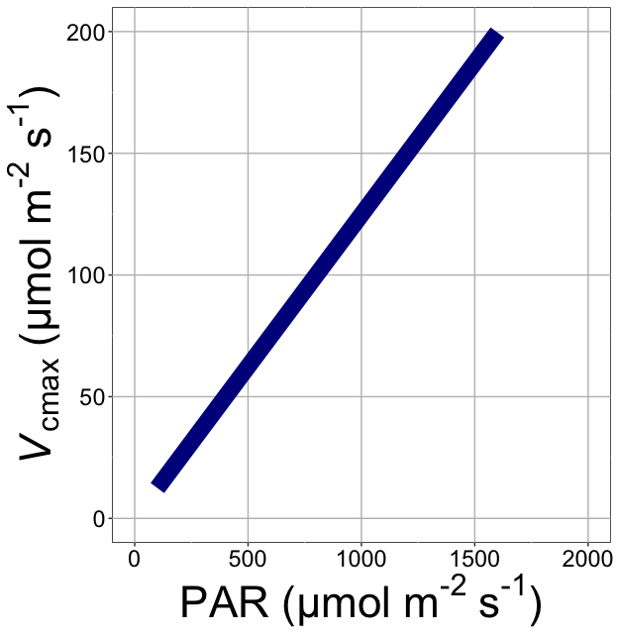
nick.smith@ttu.edu; @nick_greg_smith
V_{cmax} increases with light because of greater electron transport
Smith et al. (2019)

Slide 43
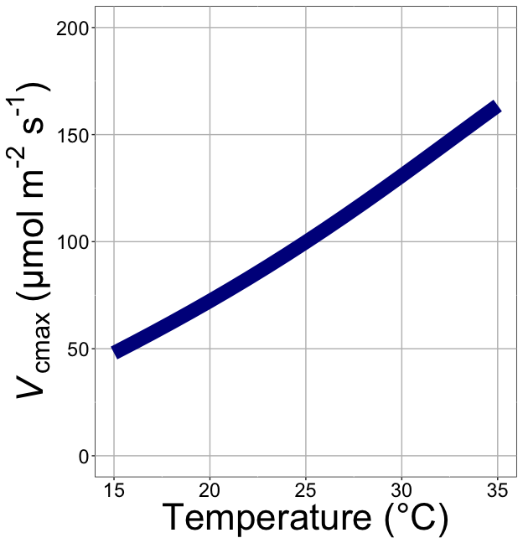
nick.smith@ttu.edu; @nick_greg_smith
V_{cmax} increases with temperature because of greater electron transport and photorespiration
Smith et al. (2019)

Slide 44
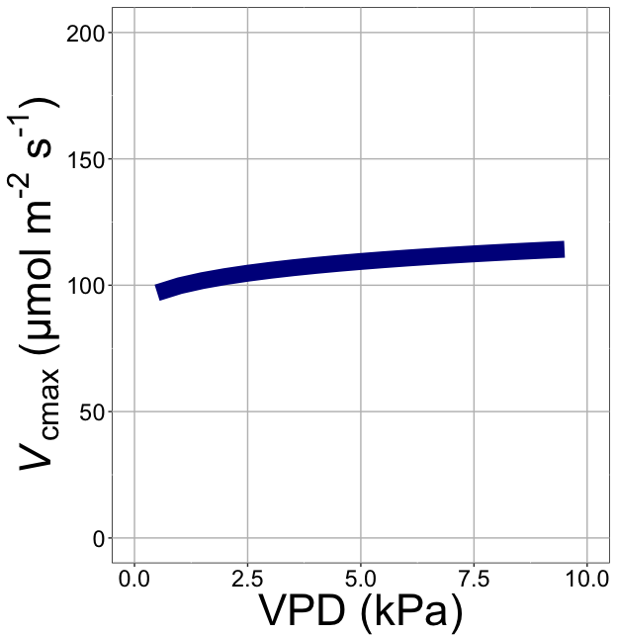
nick.smith@ttu.edu; @nick_greg_smith
V_{cmax} increases with VPD because of lower stomatal conductance
Smith et al. (2019)

Slide 45
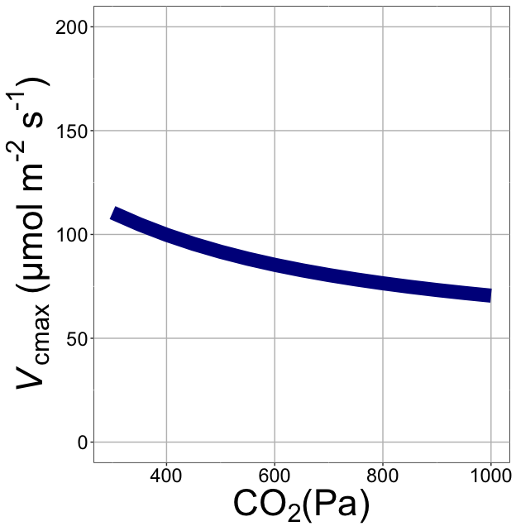
nick.smith@ttu.edu; @nick_greg_smith
V_{cmax} decreases with CO₂ because of greater CO₂ in the leaf
Smith et al. (2019)

Slide 46
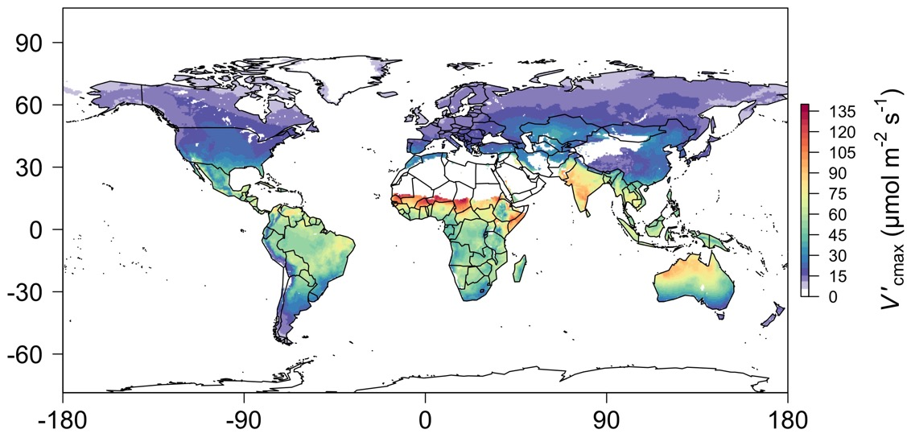
nick.smith@ttu.edu; @nick_greg_smith
We can predict optimal traits in different environments
Smith et al. (2019)

Slide 47
Ok, great, but now what?
nick.smith@ttu.edu; @nick_greg_smith

Slide 48
We can use the theory as a null model to explore acclimation mechanisms
nick.smith@ttu.edu; @nick_greg_smith

Slide 49
Let’s tackle some big questions in plant ecophysiology!
nick.smith@ttu.edu; @nick_greg_smith

Slide 50
Big questions
Is photosynthesis optimized to the environment?
Does photosynthesis acclimate to soil nutrients?
What does acclimation mean for future terrestrial biogeochemical cycling?
When is C₄ photosynthesis an advantage over C₃ photosynthesis?

Slide 51
Question 1: Is photosynthesis optimized to the environment?
nick.smith@ttu.edu; @nick_greg_smith

Slide 52
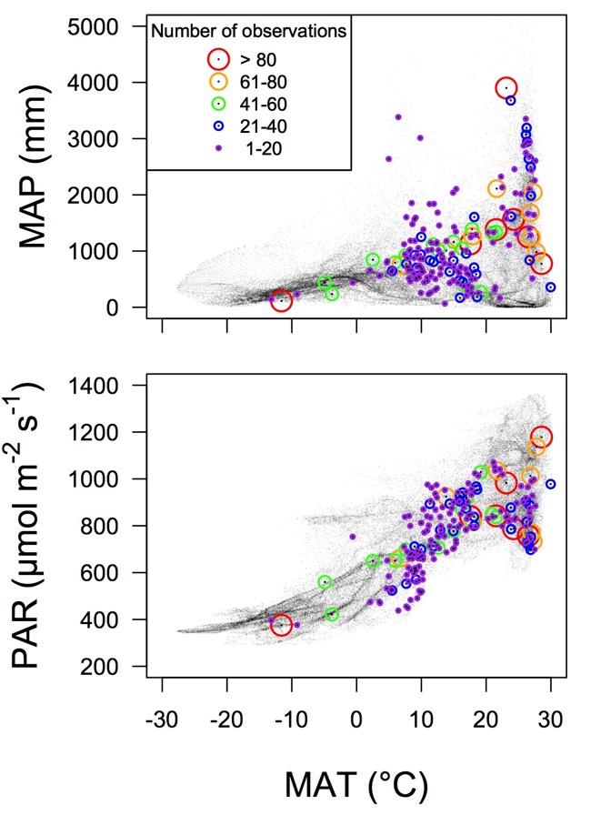
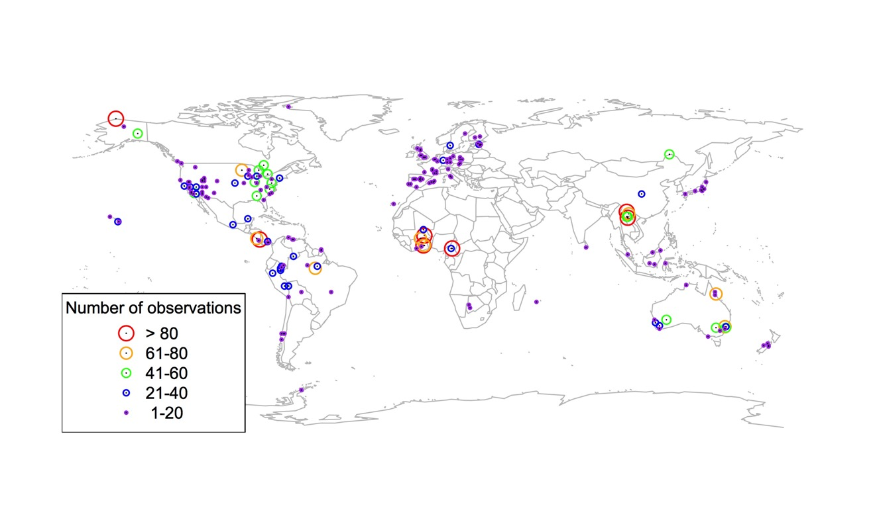
Global V_{cmax} dataset
nick.smith@ttu.edu; @nick_greg_smith
3,697 measurements
202 sites
> 600 genera
Smith et al. (2019)

Slide 53

nick.smith@ttu.edu; @nick_greg_smith
Smith et al. (2019)

Slide 54
nick.smith@ttu.edu; @nick_greg_smith
Optimal V_{cmax} is similar to observed values
Smith et al. (2019)

Slide 55
Question 1: Is photosynthesis optimized to the environment? YES! Photosynthesis acclimates spatially as expected from optimization
nick.smith@ttu.edu; @nick_greg_smith

Slide 56
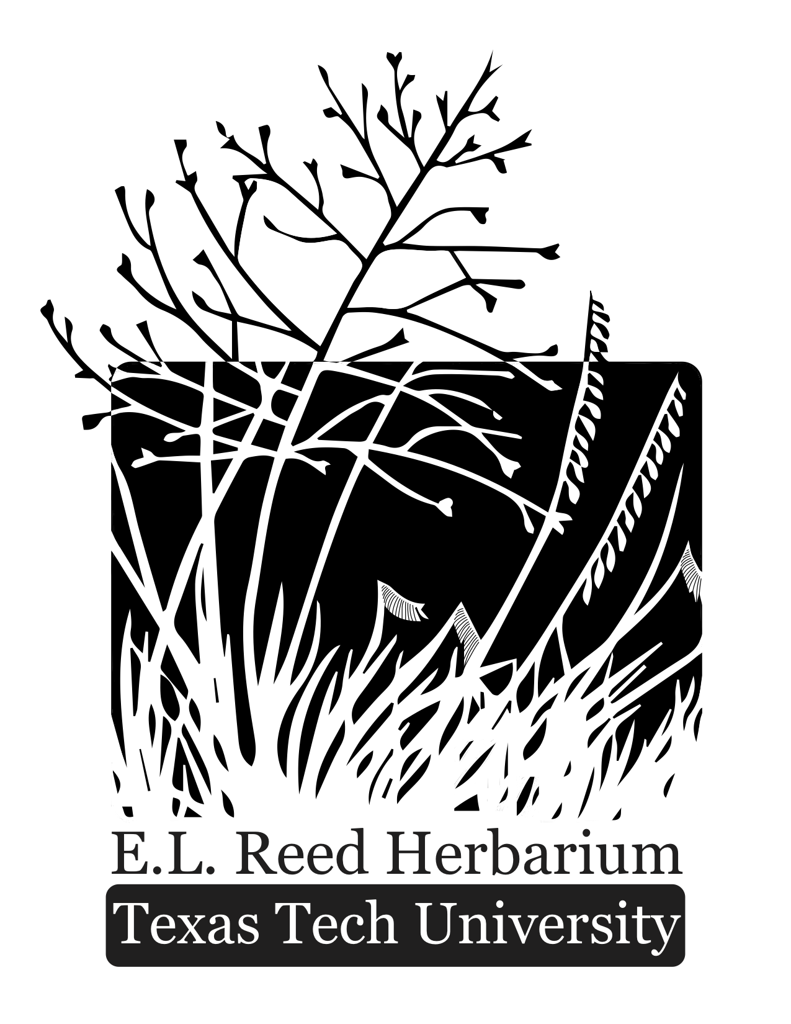
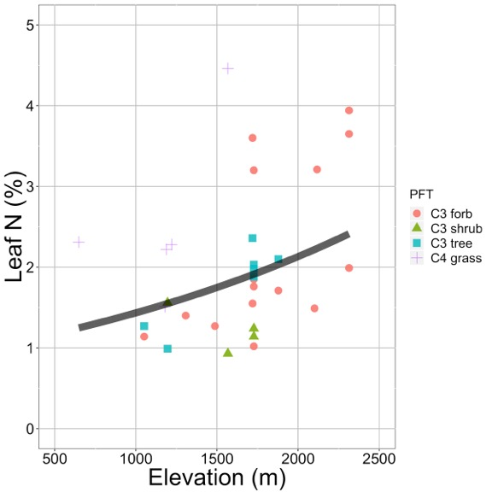
Looking forward: herbarium specimens to examine acclimation over space and time
nick.smith@ttu.edu; @nick_greg_smith
Plants increased leaf N investment with elevation. This response was predicted by acclimation theory.
Villeda et al. (in prep)

Slide 57
Question 2: Does photosynthesis acclimate to soil nutrients?
nick.smith@ttu.edu; @nick_greg_smith

Slide 58
From the least cost hypothesis
nick.smith@ttu.edu; @nick_greg_smith
Added nutrients will not increase photosynthesis because light limitation will kick in, instead …

Slide 59
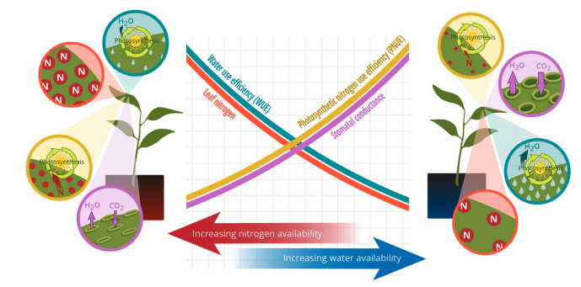
From the least cost hypothesis
nick.smith@ttu.edu; @nick_greg_smith
Bialic-Murphy et al. (2021)

Slide 60
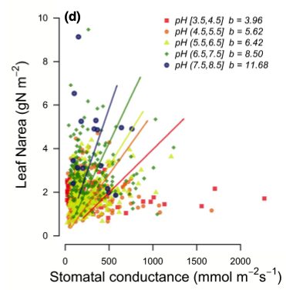
Observations show support for least cost
nick.smith@ttu.edu; @nick_greg_smith
Paillassa et al. (2020)

Slide 61
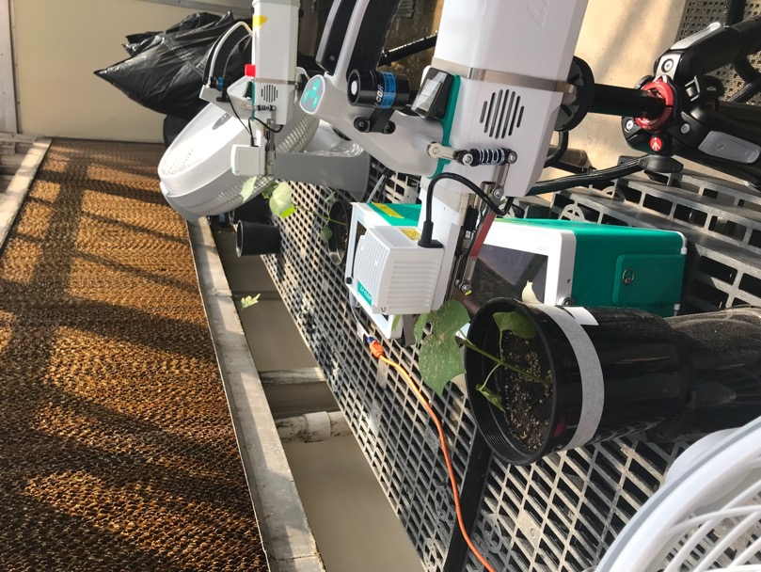
As do greenhouse experiments
nick.smith@ttu.edu; @nick_greg_smith
Waring and Smith (in prep)

Slide 62
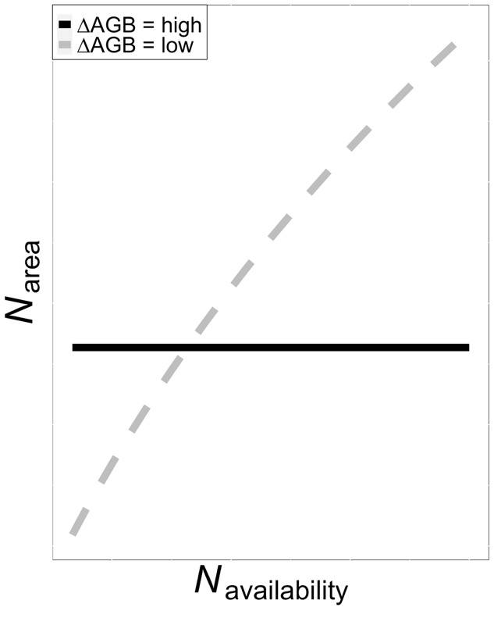
Is plant allocation to leaf N dependent on allocation to biomass?
nick.smith@ttu.edu; @nick_greg_smith

Slide 63
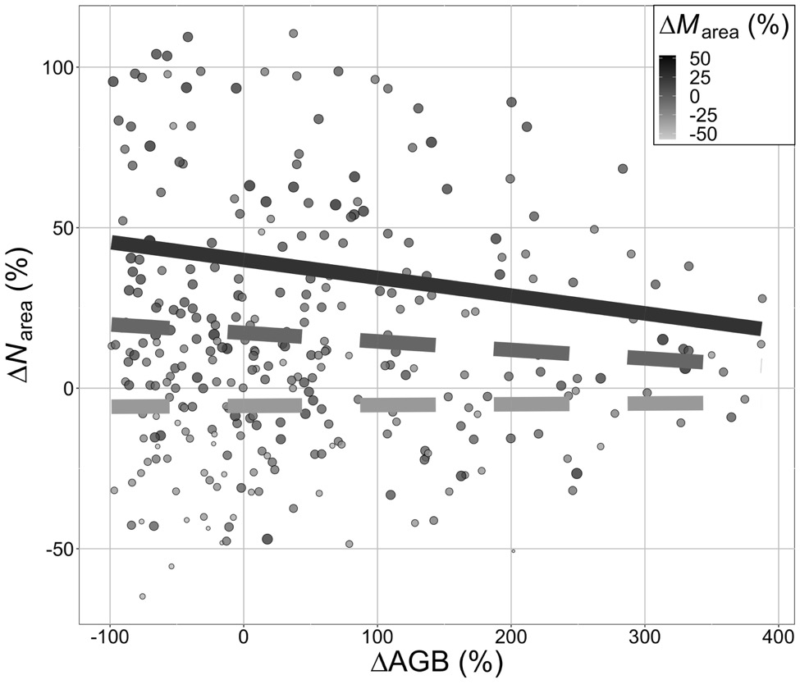
Is plant allocation to leaf N dependent on allocation to biomass?
nick.smith@ttu.edu; @nick_greg_smith
Smith et al. (in prep)

Slide 64
To see a leaf N response to soil N there must be (1) added investment to leaves and (2) small investment to biomass
nick.smith@ttu.edu; @nick_greg_smith
Smith et al. (in prep)

Slide 65
Question 2: Does photosynthesis acclimate to soil nutrients? Yes, although this is dependent on whole-plant allocation decisions
nick.smith@ttu.edu; @nick_greg_smith

Slide 66
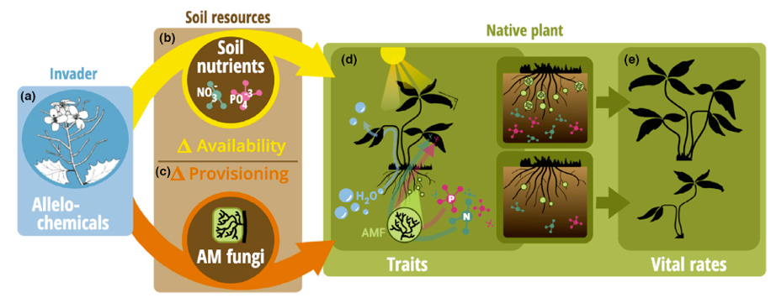
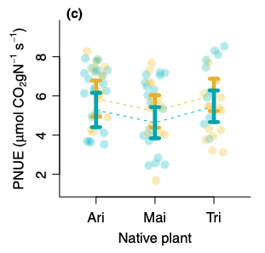
Looking forward: impact of allelopathic invaders on leaf economics
nick.smith@ttu.edu; @nick_greg_smith
Allelopathic invasion (gold) increased photosynthetic N use efficiency of native plants. This response was predicted by acclimation theory.
Bialic-Murphy et al. (2021)

Slide 67

Question 3: What does acclimation mean for future terrestrial biogeochemical cycling?
nick.smith@ttu.edu; @nick_greg_smith

Slide 68
Expected future responses
nick.smith@ttu.edu; @nick_greg_smith
V_{cmax} decreases with CO₂ because of greater CO₂ in the leaf
Smith et al. (2019)

Slide 69
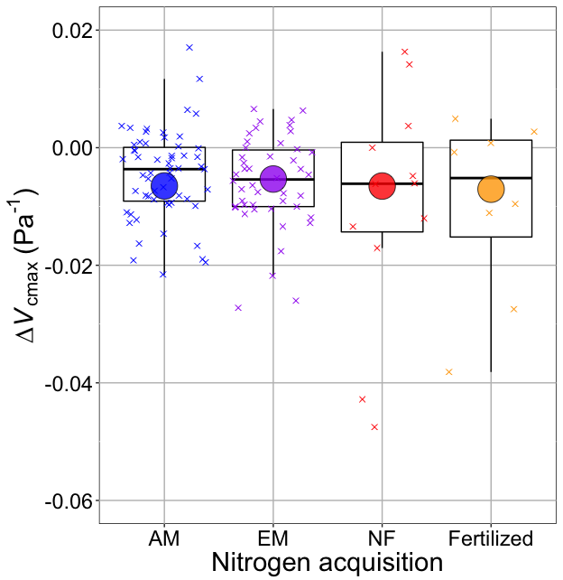
nick.smith@ttu.edu; @nick_greg_smith
Smith and Keenan (2020)

Slide 70
V_{cmax} changes with CO₂ in ways expected from optimization
nick.smith@ttu.edu; @nick_greg_smith
Boxes = data = -0.0063 Pa⁻¹
Circles = predicted = -0.0066 Pa⁻¹
Smith and Keenan (2020)

Slide 71
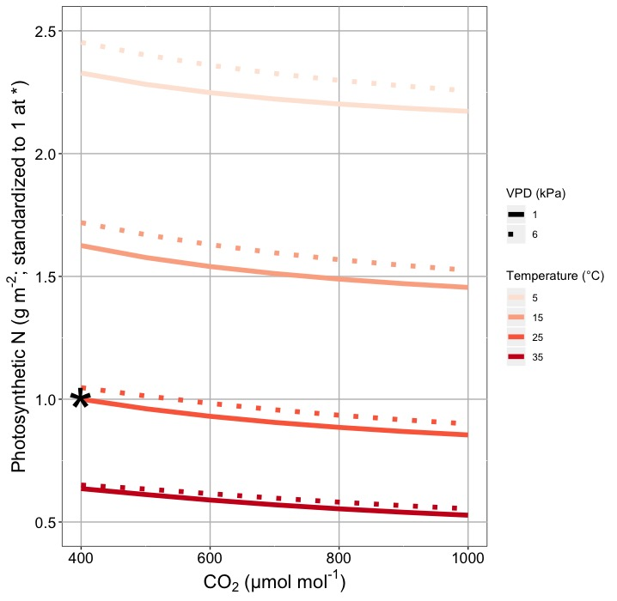
This generally suggests lower nitrogen demand under future conditions
nick.smith@ttu.edu; @nick_greg_smith
Smith and Keenan (2020)

Slide 72
Let’s run a model out into the future!
nick.smith@ttu.edu; @nick_greg_smith

Slide 73
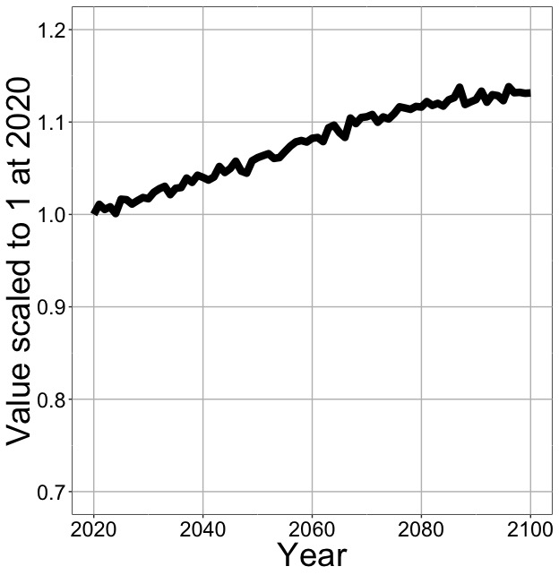
Photosynthesis increases in future
nick.smith@ttu.edu; @nick_greg_smith
Net Photosynthesis
Smith et al. (in prep)

Slide 74
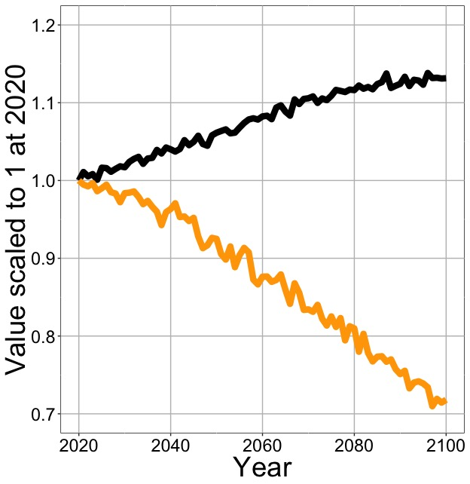
Photosynthesis increases in future (at lower nutrient use)
nick.smith@ttu.edu; @nick_greg_smith
Net Photosynthesis
Leaf Nitrogen
Smith et al. (in prep)

Slide 75
Need to rethink nutrient limitation in models?
“No limitation” simulation
“Nutrient limitation” simulations
Weider et al. (2015)

Slide 76
Question 3: What does acclimation mean for future terrestrial biogeochemical cycling? Photosynthesis will increase and per-leaf-area nutrient use will decrease
nick.smith@ttu.edu; @nick_greg_smith

Slide 77
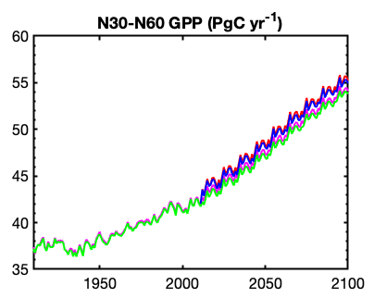
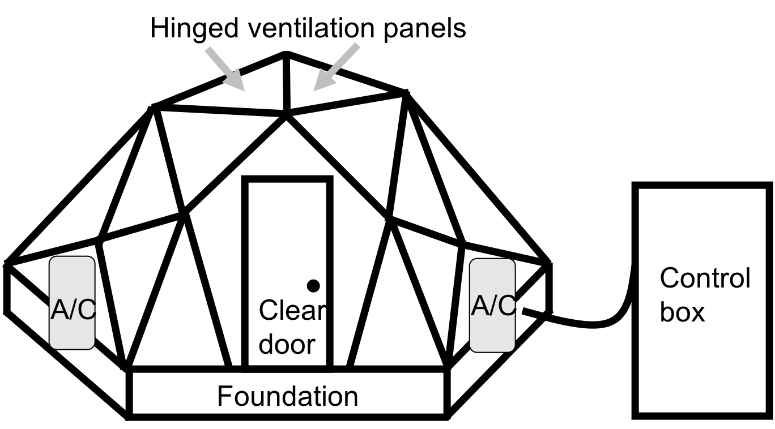
Looking forward: role of acclimation on future ecosystem feedbacks to global change
nick.smith@ttu.edu; @nick_greg_smith
Coupled model-data experiments

Slide 78
Question 4: When is C₄ photosynthesis an advantage over C₃ photosynthesis?
nick.smith@ttu.edu; @nick_greg_smith

Slide 79
C₃ versus C₄ optimization
nick.smith@ttu.edu; @nick_greg_smith

Slide 80
C₄ versus C₃ optimization
nick.smith@ttu.edu; @nick_greg_smith
C₄ photosynthesis has…
No photorespiration
An additional limitation (PEP carboxylation)

Slide 81
C₄ versus C₃ optimization
nick.smith@ttu.edu; @nick_greg_smith
C₄ photosynthesis has…
No photorespiration
An additional limitation (PEP carboxylation)

Slide 82
nick.smith@ttu.edu; @nick_greg_smith
Relative advantage of C₄ physiology
Scott and Smith (2021; in review)

Slide 83
nick.smith@ttu.edu; @nick_greg_smith
Relative advantage of C₄ physiology
Scott and Smith (2021; in review)

Slide 84
nick.smith@ttu.edu; @nick_greg_smith
Relative advantage of C₄ physiology
Scott and Smith (2021; in review)

Slide 85
nick.smith@ttu.edu; @nick_greg_smith
Relative advantage of C₄ physiology
Scott and Smith (2021; in review)

Slide 86
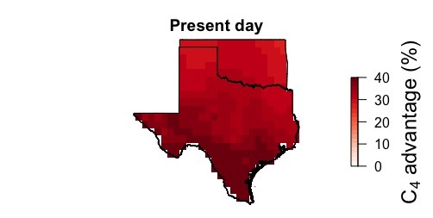
nick.smith@ttu.edu; @nick_greg_smith
Ansley et al. (in prep)

Slide 87
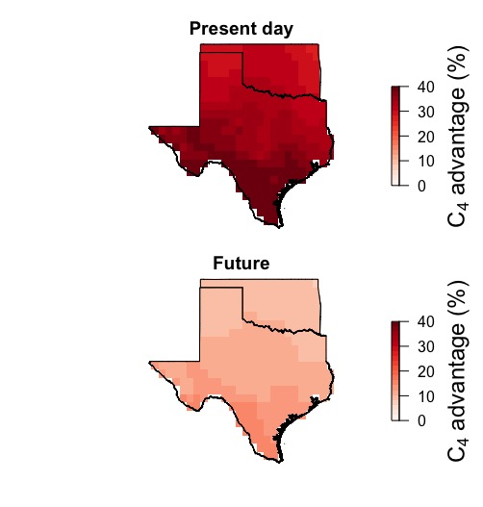
nick.smith@ttu.edu; @nick_greg_smith
Ansley et al. (in prep)

Slide 88
Question 4: When is C₄ photosynthesis an advantage over C₃ photosynthesis? C₄ is better in hot, dry, low CO₂ environments
nick.smith@ttu.edu; @nick_greg_smith

Slide 89
Looking forward: model-data comparisons for C₄ plants
nick.smith@ttu.edu; @nick_greg_smith
Early initiatives include:
C₄ trait meta-analysis and database
C₄ model intercomparison

Slide 90
Conclusions
nick.smith@ttu.edu; @nick_greg_smith

Slide 91
Conclusions
nick.smith@ttu.edu; @nick_greg_smith
Plants aren’t dumb!
Assuming plants don’t dynamically respond to their environment can lead to poor understanding of ecosystem functioning
Dumb plants

Slide 92
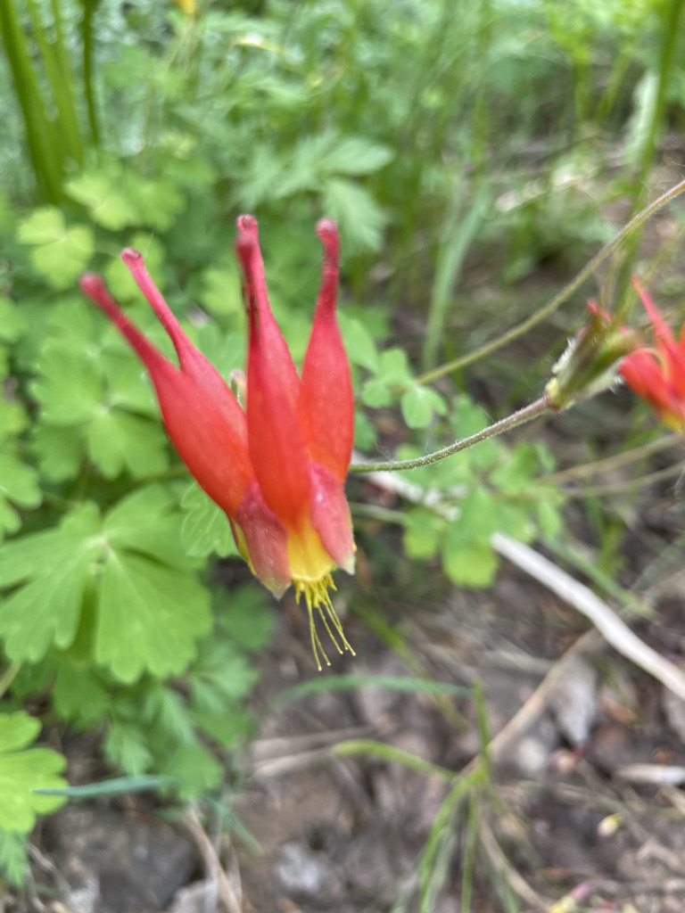
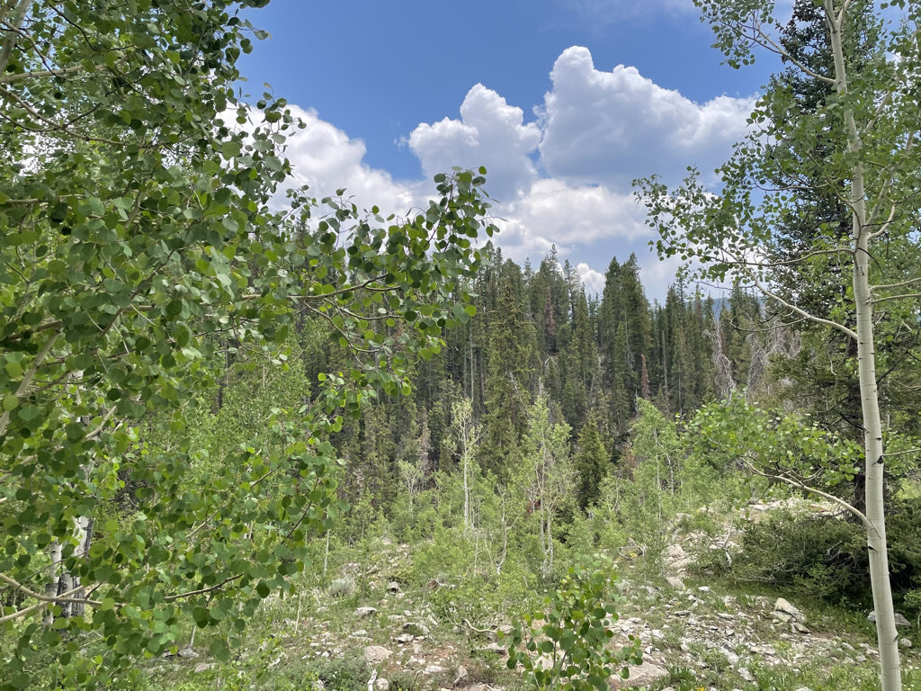
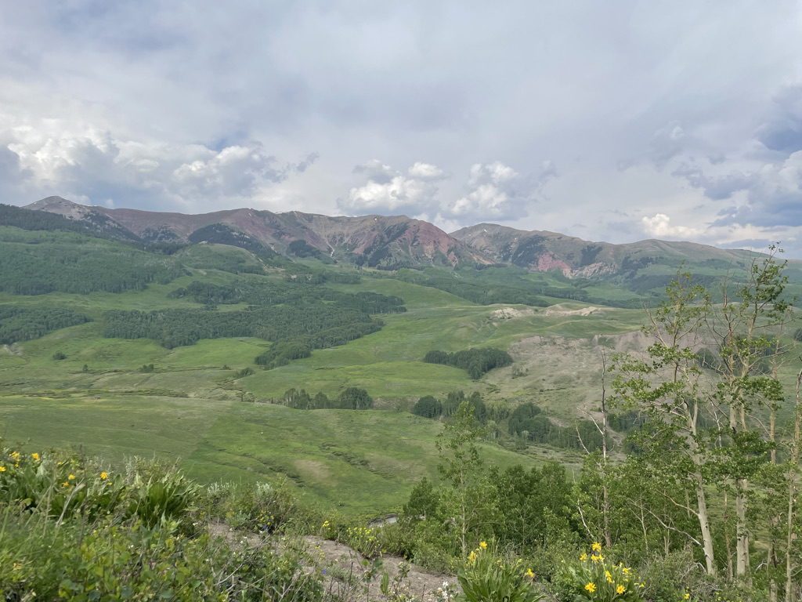
Conclusions
nick.smith@ttu.edu; @nick_greg_smith
Quantified physiological theory can:
Improve mechanistic understanding of physiological processes that underlie higher level responses
Produce more reliable future projections
f(x)
f(x)

Slide 93
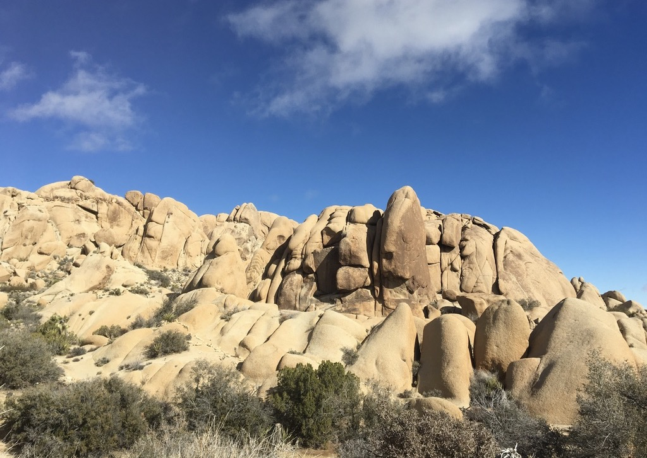
nick.smith@ttu.edu; @nick_greg_smith
Presentation available at:
www.github.com/SmithEcophysLab/seminar/2021_michigan
Thanks!

Slide 94
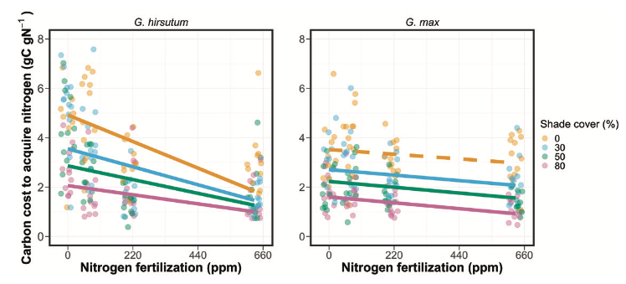
Looking forward: symbioses as modifiers of plant economies under variable conditions
nick.smith@ttu.edu; @nick_greg_smith
Soybean (right panel) economics are much less responsive to soil nitrogen than cotton (left panel)
Perkowski et al. (2021)

Slide 95
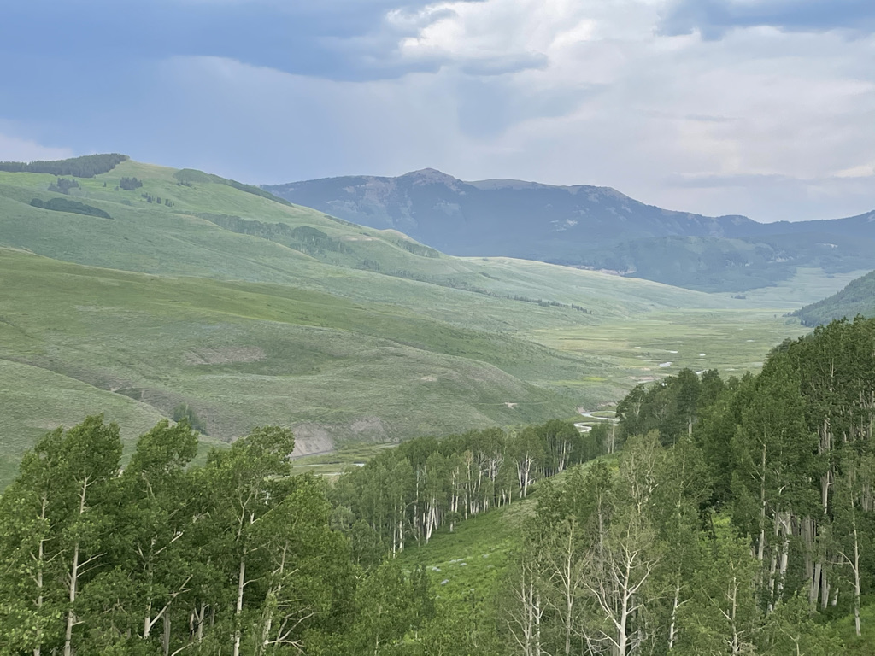
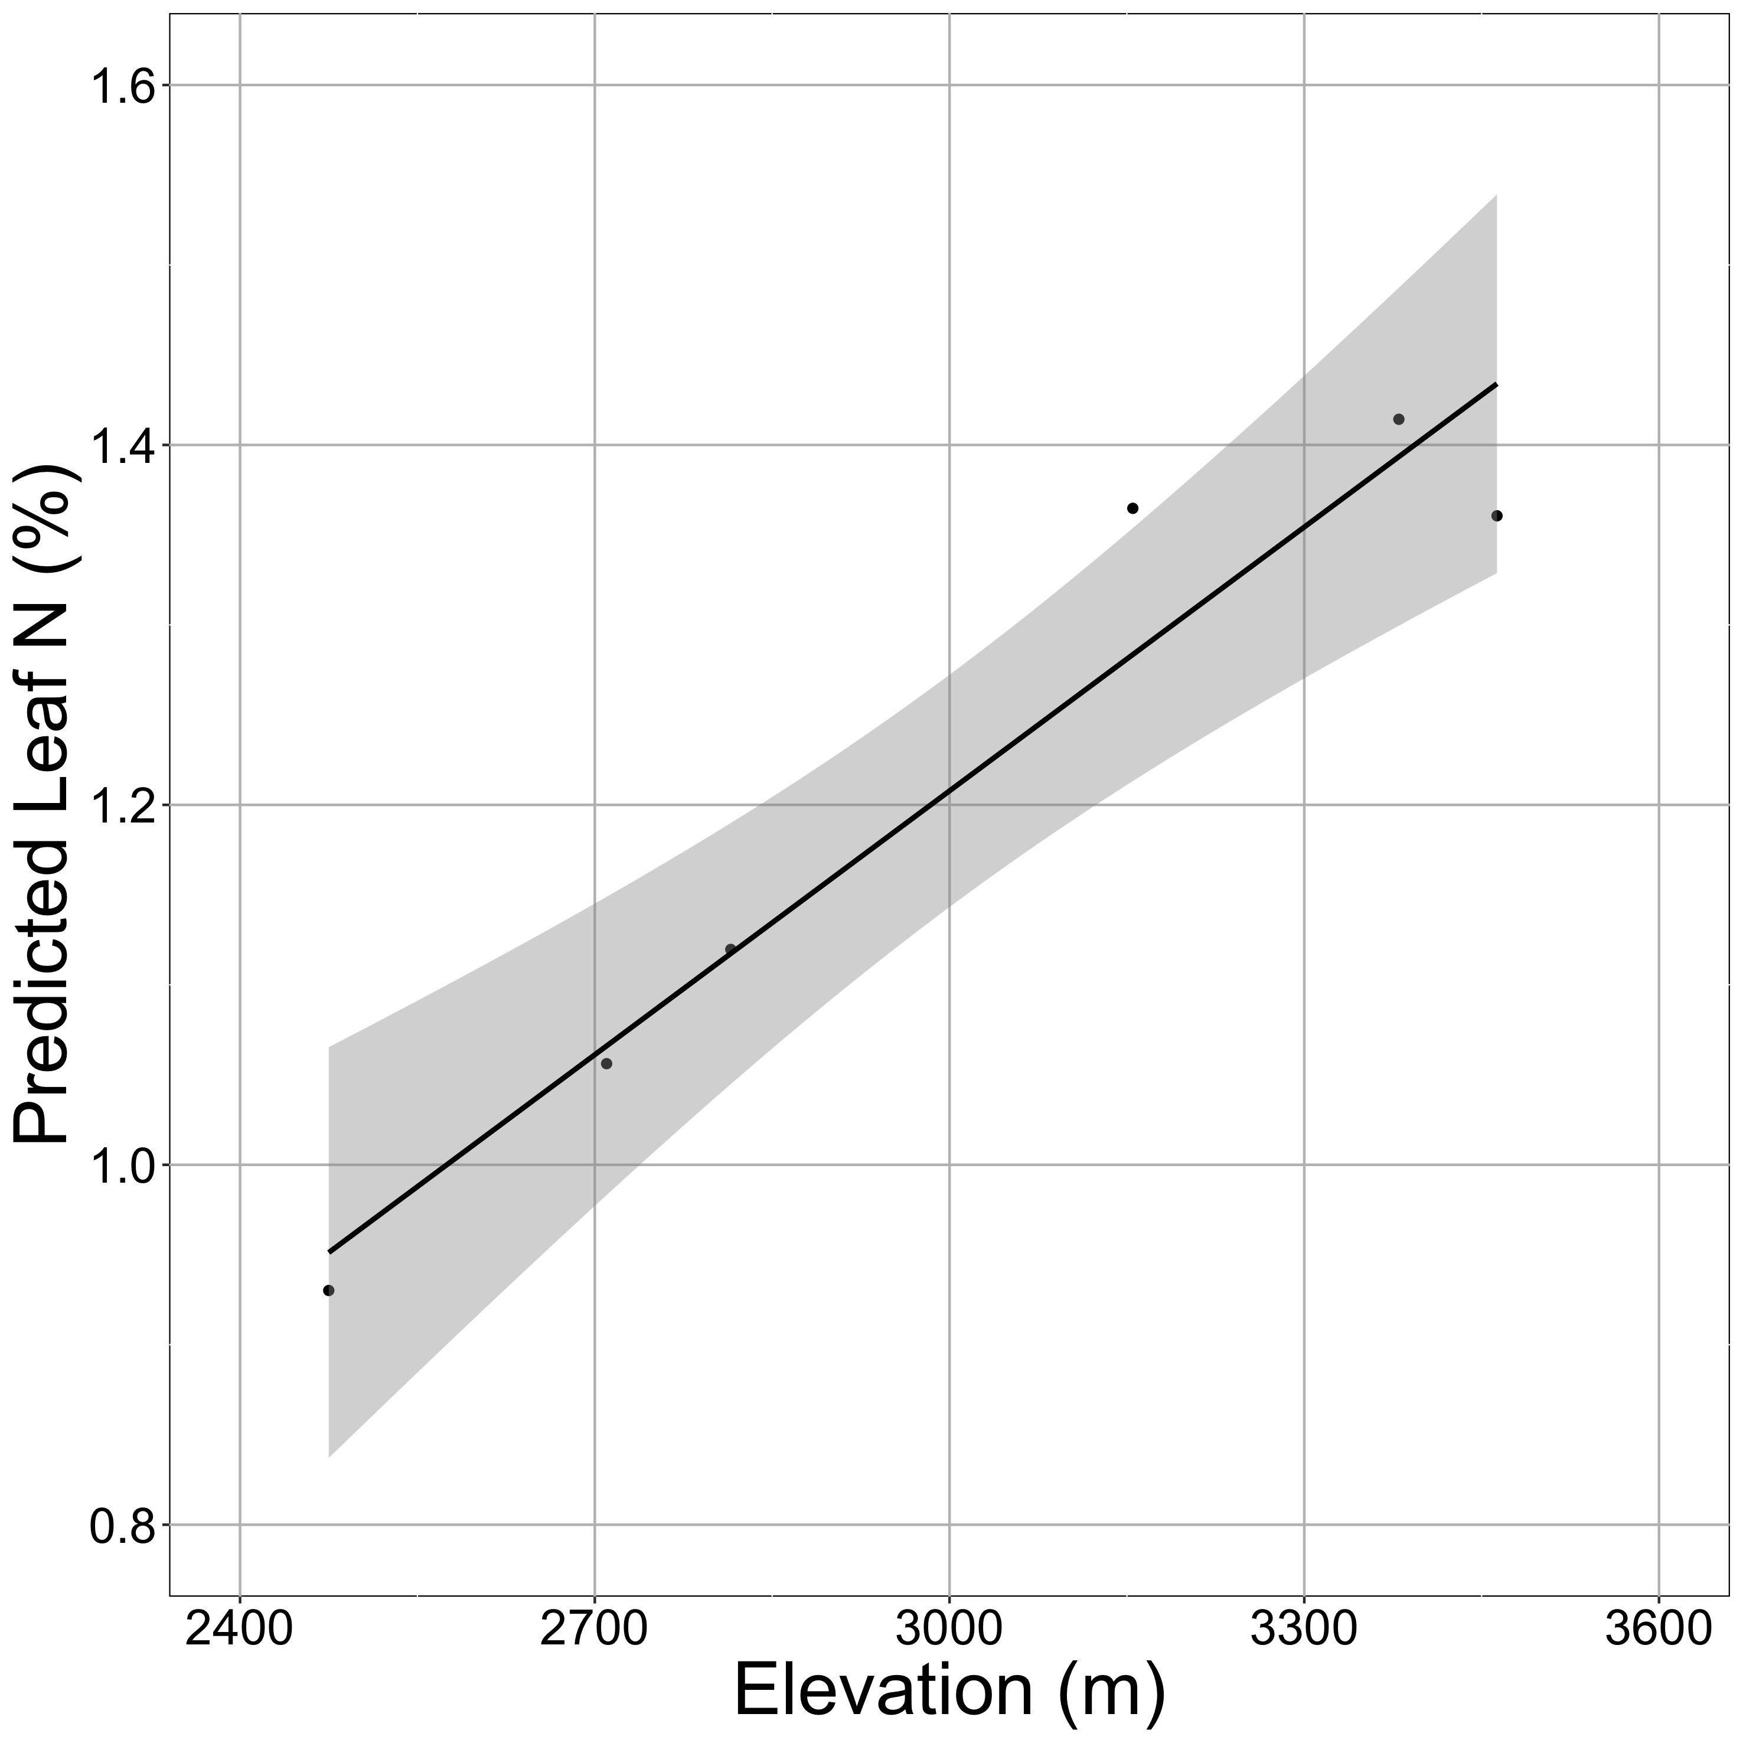
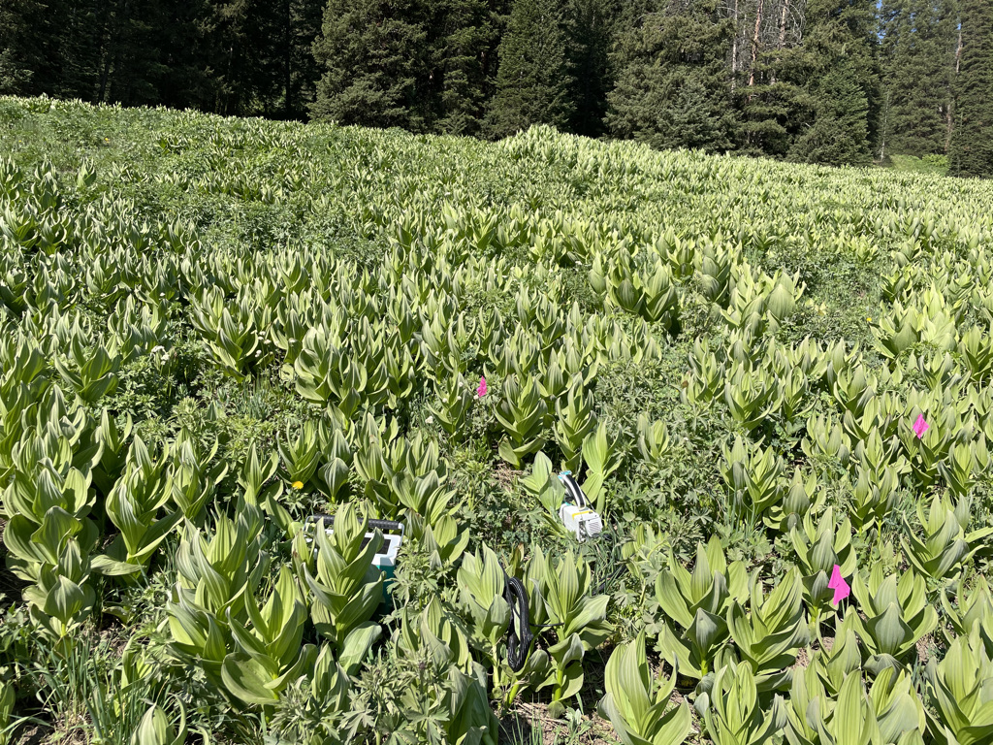

Looking forward: more acclimation predictions in more places to examine larger scale impacts
nick.smith@ttu.edu; @nick_greg_smith

Slide 96
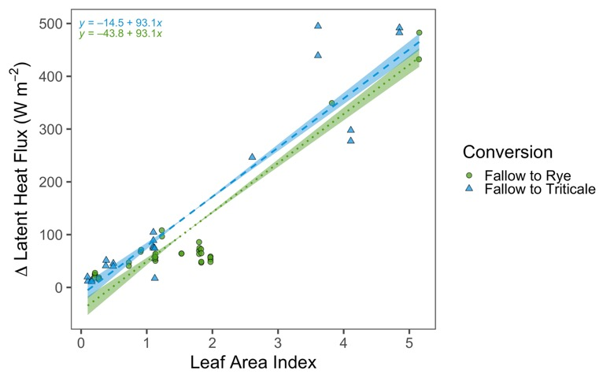

Looking forward: other ongoing and future research
nick.smith@ttu.edu; @nick_greg_smith
Land management modifications of plant-atmosphere feedbacks
Cover crop implementation increases latent heat flux (left) and albedo (right) as compared to fallow fields.
McNellis et al. (in review)

Slide 97
nick.smith@ttu.edu; @nick_greg_smith
Open stomata:
Benefits
High CO₂ influx
Costs
High water outflux
Closed stomata:
Benefits
Low water outflux
Costs
Low CO₂ influx

Slide 98
nick.smith@ttu.edu; @nick_greg_smith
Open stomata:
Benefits
High CO₂ influx
Costs
High water outflux
Closed stomata:
Benefits
Low water outflux
Costs
Low CO₂ influx
Must maintain high amount of Rubisco to do photosynthesis

Slide 99
Optimal stomatal conductance
nick.smith@ttu.edu; @nick_greg_smith
Optimal conductance maximizes photosynthesis at least water loss and nutrient use
Water loss is from transpiration
Nutrient use is nutrients used to maintain Rubisco
[TALK TO ME LATER ABOUT THE MATHS]

Slide 100
Stomatal conductance trait The ratio of CO₂ in the leaf to CO₂ outside of the leaf (C_{i}/C_{a})

Slide 101

nick.smith@ttu.edu; @nick_greg_smith
C_{i}/C_{a} increases with temperature because of greater photorespiration
Smith et al. (2019)

Slide 102

nick.smith@ttu.edu; @nick_greg_smith
C_{i}/C_{a} decreases with VPD to avoid water loss
Smith et al. (2019)

Slide 103

nick.smith@ttu.edu; @nick_greg_smith
C_{i}/C_{a} decreases with CO₂ because of lower openness needed to satisfy Rubisco
Smith et al. (2019)

Slide 104

nick.smith@ttu.edu; @nick_greg_smith
Smith and Keenan (2020)

Slide 105
Photosynthetic traits change with temperature in ways expected from optimization
nick.smith@ttu.edu; @nick_greg_smith
Data = -0.051 °C⁻¹
Predicted = -0.048 °C⁻¹
Smith and Keenan (2020)

